Slide 1




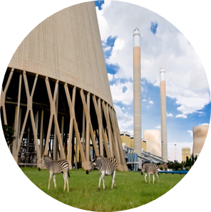

Tutorial B T-pipe junction Static FEM model
By Ofentse Kgoa
kgoaot@eskom.co.za

Slide 2
Introduction
Background:
It is assumed that Tutorial A is completed.
Objectives:
Open an existing FreeCAD project
Prepare CAD geometry for FEM modeling
Set up a Mesh from CAD geometry in a FEM model
Select a material in a FEM model
Set up boundary conditions in a FEM model
Run a static FEM model
Evaluate and analyze the static FEM results
Save the FreeCAD project

Slide 3
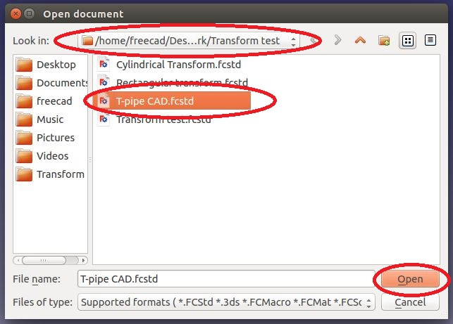
Project start Up
Open an existing project:
To open an existing project, click on <Open a document or import files>
A task dialogue appears, choose the directory the file directory, select the project to be opened and then click on <Open>

Slide 4
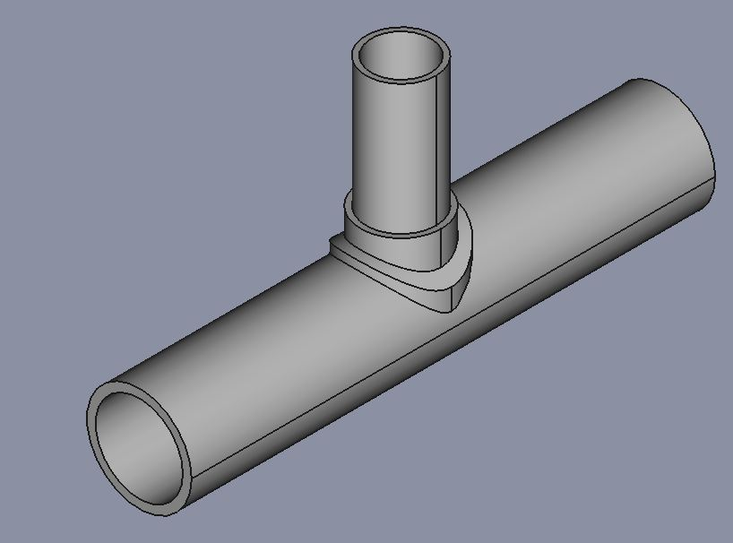
Static FEM model – Pre-processing
Notes and assumptions:
The analysis to be run is a static analysis. In a static analysis all CAD parts are considered to be stationary deformable parts.
Furthermore in a static analysis, only stresses and displacements are solved for.
The T-pipe junction is subjected to an internal surface pressure of 9 MPa. This pressure was stated as the operating pressure in Tutorial A.

Slide 5
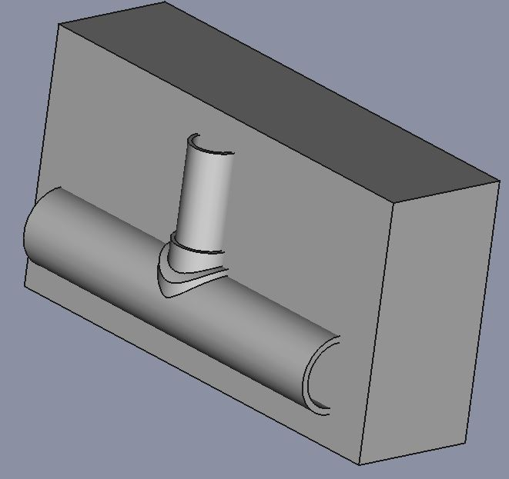
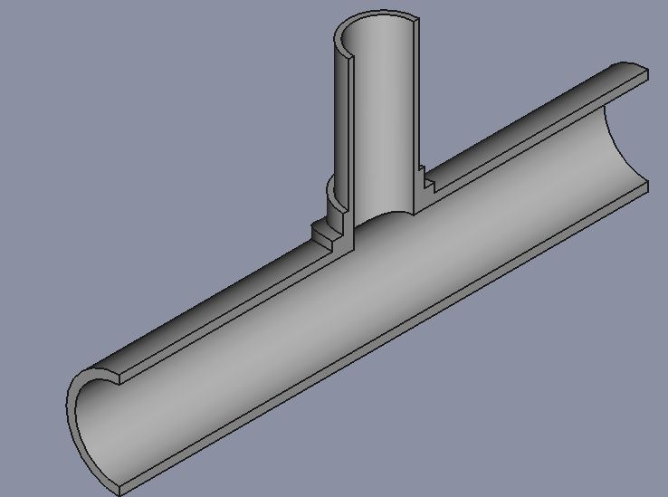
Static FEM model – Pre-processing
Preparing the geometry:
Go to the Part workbench
In order to constrain the T-pipe in the X, Y and Z directions (to prevent rigid body motion), the T-pipe needs to be cut in half. This can be done in this particular case because the T-pipe is symmetrical.
Create a cube as indicated in the figure to cut the T-pipe in half.
After making the cut the geometry should be similar to that depicted in the picture.

Slide 6
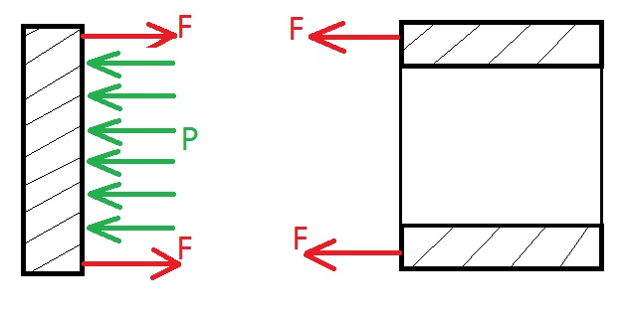
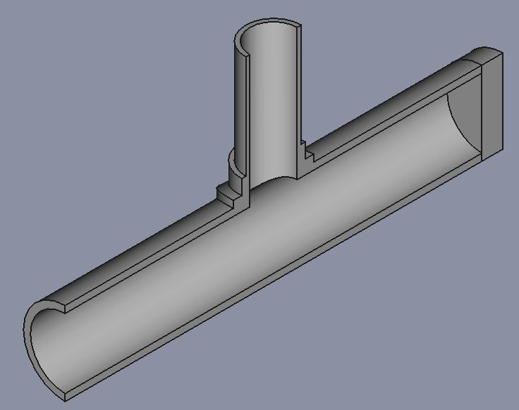
Static FEM model – Pre-processing
Preparing the geometry:
The pipe will be subjected to an internal pressure and it will therefore be under longitudinal stresses and hoop stresses.
To properly account for the longitudinal stress acting on one of the ends of the pipe, an end cap is placed at the particular end of the pipe.
The diagram indicates how the pressure on the internal surface of the cap transfers a resultant force on the end pipe surface.

Slide 7
Static FEM model – Pre-processing
Preparing the geometry:
Create a cylinder with 150 mm and a height of 75 mm (3X thickness of pipe) so that it does not significantly deform.
Rotate this end cap 90° about the X-axis. Translate it 825 mm in the Y-direction. Cut the T-pipe in half. Join the end cap to the T-pipe.
Instead of placing an end cap on the T-pipe to account for the longitudinal stress, the user can just simply calculate the force F or the longitudinal stress acting on the end face of the T-pipe.

Slide 8
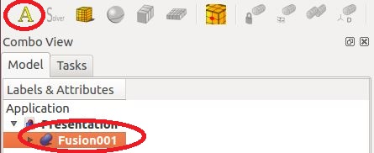
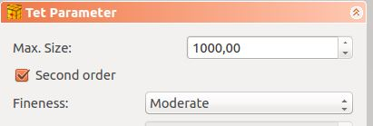
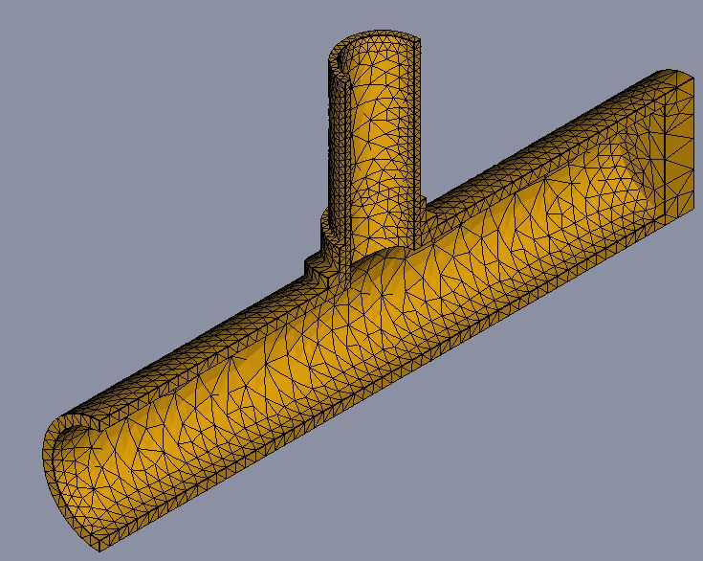
Static FEM model – Pre-processing
Creating the Mesh:
To create a mesh, go to the FEM workbench and select the geometry in the object tree view.
Click on <Create a new mechanical analysis>. A task dialogue will appear for creating a mesh. Only Tetrahedral (Tet) meshing is possible.
Leave all settings as default and click <OK>.The mesh of the T-pipe junction should be similar to that on the right
It is important to note that the finer the mesh is the more accurate the results, but more computing time is required to create the mesh and solve the model.

Slide 9
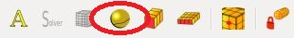
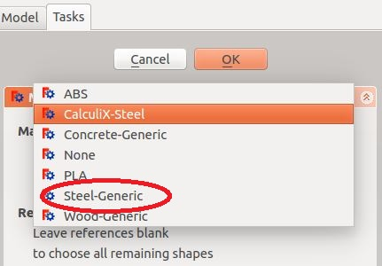
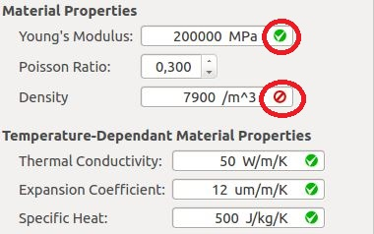
Static FEM model – Pre-processing
Material specification:
In the material task dialogue different materials can be chosen, choose “Steel-Generic”.
The user can further change the material properties of a specific material to suit their needs. It is very important to stick to the units displayed in any input box used in FreeCAD.
When FreeCAD accepts the units a green tick appears next to the units as indicated.

Slide 10
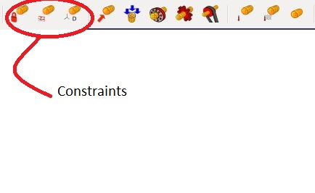
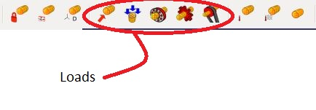
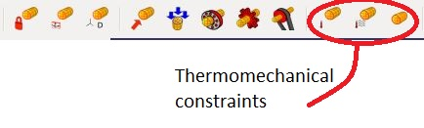
Static FEM model – Pre-processing
Boundary conditions:
The user has access to different types of boundary conditions which include displacement, load and temperature. It is important to note that for any feature( vertex, edge or face) either a displacement or a load boundary condition can be used for a particular direction. The temperature boundary condition can be used even if a structural boundary condition is applied
It is important to note that the geometry needs to be constrained to prevent any rigid body motion of the pipe junction.

Slide 11
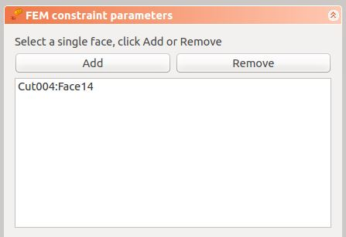
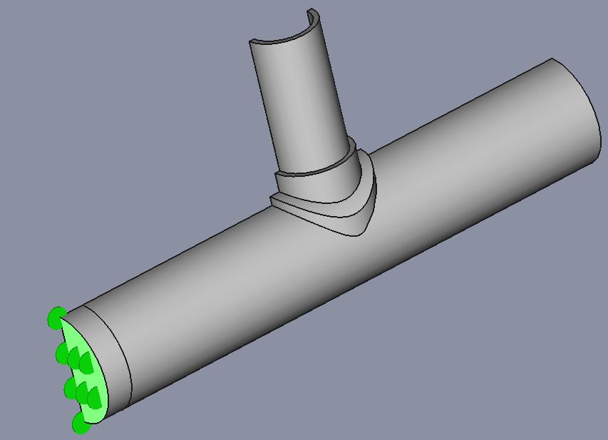
Static FEM model – Pre-processing
Boundary conditions:
In reality there will be more pipe material on either ends of the T-pipe junction and the model needs to account for that with the boundary conditions.
As there will be more pipe material on either ends of the pipe, the material on these pipes needs to always remain plane. This can be done by applying <Create FEM constraint for Plane Rotation face> on the outer surface of the cap.
A task dialogue will appear, select the face indicated and then click <Add> and then <OK>.

Slide 12
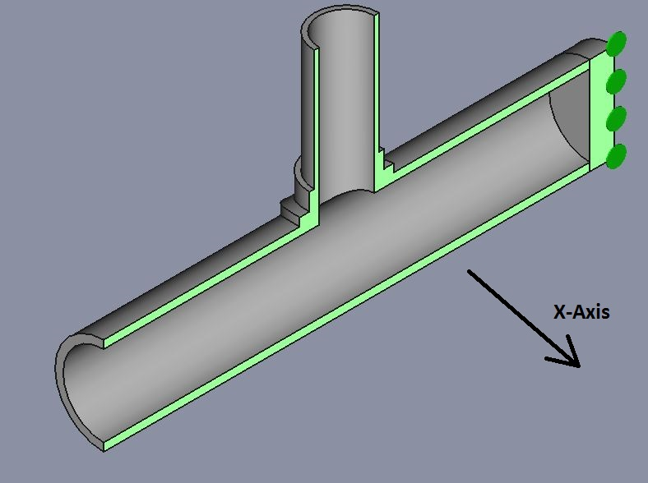
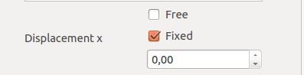
Static FEM model – Pre-processing
Boundary conditions:
Since the pipe was cut in half due to symmetry, it is important to account for this using boundary conditions. To account for symmetry the <Create FEM constraint for a displacement acting on a face> boundary condition is used.
A task dialogue will appear, click on the faces indicated in the picture and fix the face in the x-axis.
This constraint can be used to also fix rotations about the x-, y- and z-axis

Slide 13
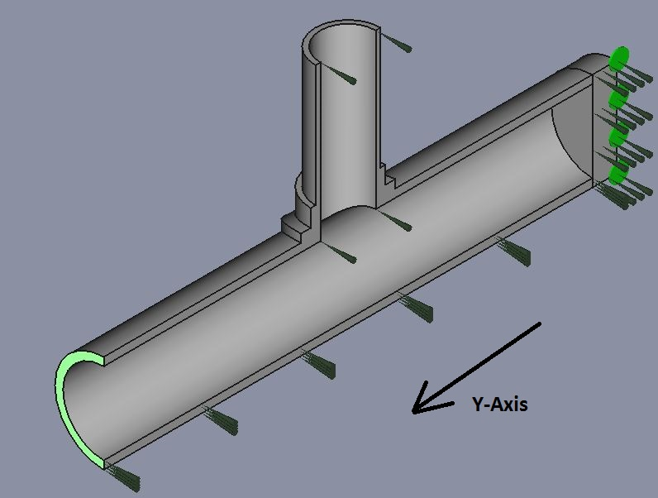
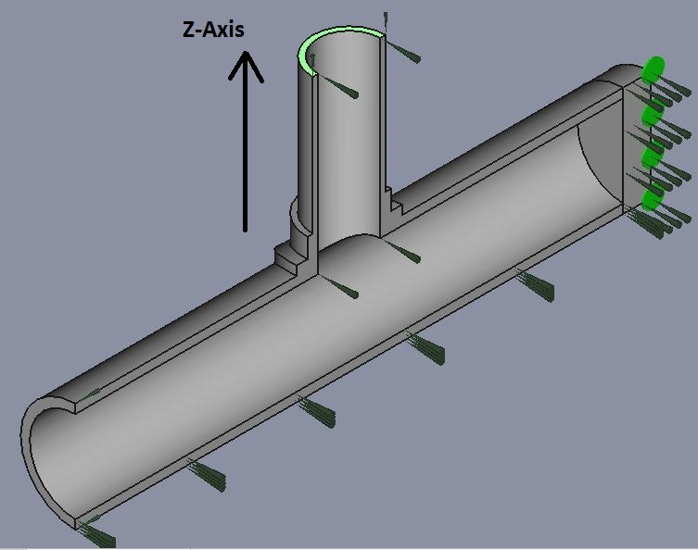
Static FEM model – Pre-processing
Boundary conditions:
Similarly fix the faces in their respective directions as indicated in the pictures.
The T-pipe junction has now been constrained in x, y and z directions and therefore no rigid body motion of the T-pipe will occur.

Slide 14
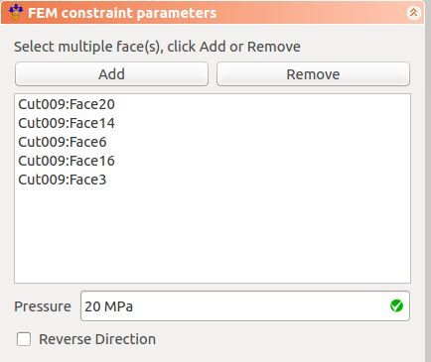
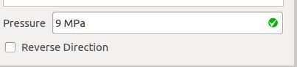
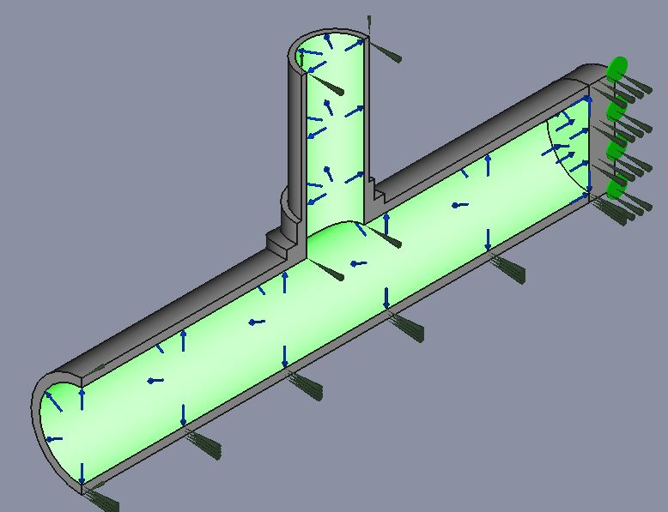
Static FEM model – Pre-processing
Boundary conditions:
Add an internal pressure to all the internal faces of the t-pipe junction as well as the internal surface of the end cap, to do so, click on <Create FEM constraint for a pressure acting on a face>
A Task dialogue will appear, select the faces indicated and click <Add>.
Input a pressure of 9 MPa as indicated in the picture.
The final geometry with all the boundary conditions should be as indicated in the picture.

Slide 15
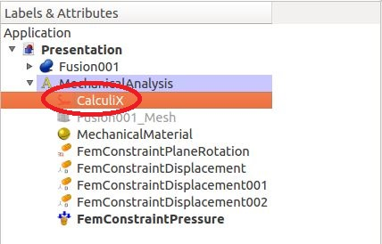
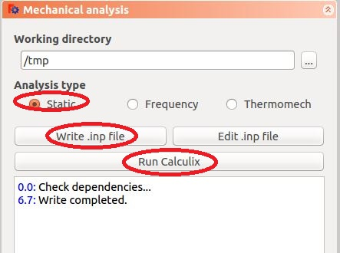
Static FEM model – Running the solver
Running the Analysis:
FreeCAD uses Calculix (ccx) as the solver. In order to run, double click on <CalculiX>
A task dialogue will appear for running the analysis. The analysis to run for the problem is a “Static” analysis. Under “Analysis type” check the radio button for “Static” as indicated.
Click on <Write .inp file> to generate the input file for Calculix. It is also possible to manually edit the input file.
Click on <Run Calculix> to run the analysis. Wait for the message “CalculiX done!” in the list box and click “Close” to complete the analysis

Slide 16
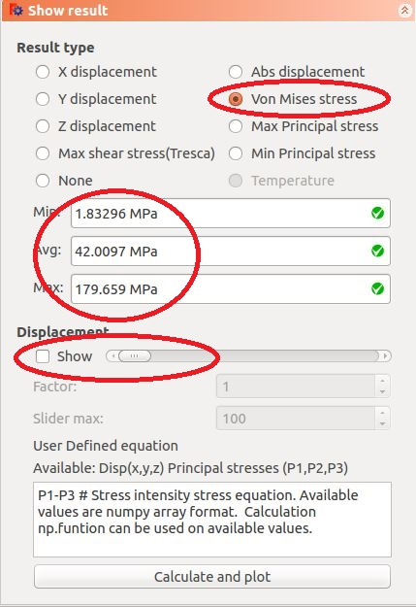
Static FEM model – Post-processing
Viewing the results:
To view the results click on <Show result information of an analysis>
The user can choose what results to display such as displacements in the X, Y or Z directions as well as the Max shear stress, Max/Min principal stress or the Von Mises stress by selecting the appropriate radio button under “Result type”. In this case the “Von Mises stress” is desired. The Min, Max and Avg are displayed.
The user can also view how the geometry deforms during the application of the load by checking the “Show” check box under “Displacement” and moving the slider accordingly.

Slide 17
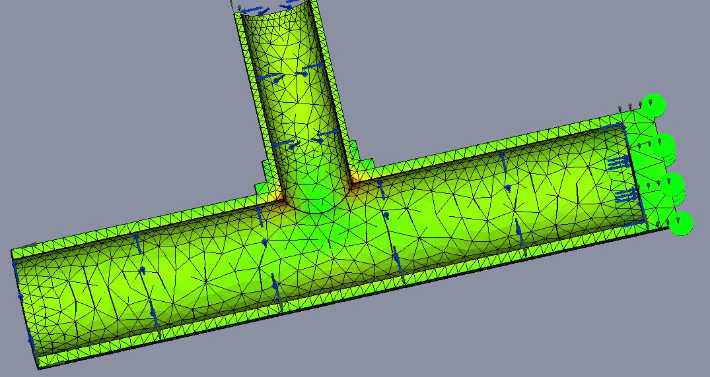
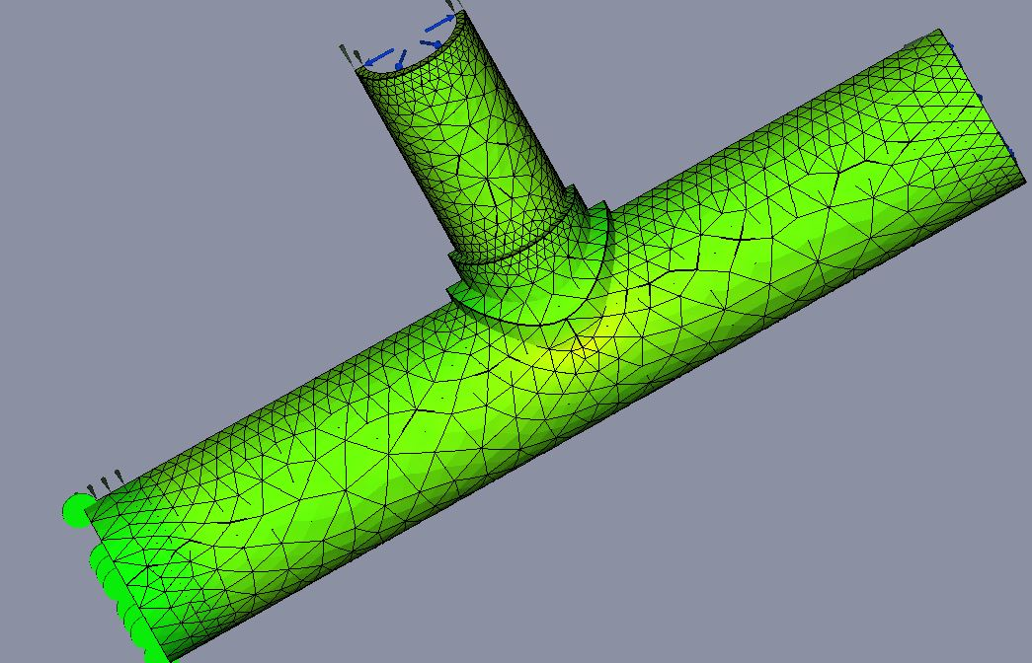
Static FEM model – Post-processing
Viewing the results:
The results are mapped out onto the geometry for visualization and interpretation.
The peak stresses are observed at the shell pipe and branch pipe junction. This happens due to the fact that the junction has a high stress concentration factor.

Slide 18
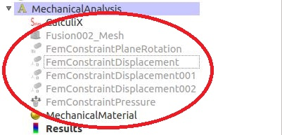
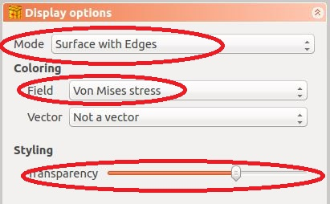
Static FEM model – Post-processing
More post processing:
Before starting with the more advanced post processing hide all constraints and loads as well as the mesh. To hide/unhide select a particular object in the object tree view and press the Spacebar
Select “Results” and then click on <Create new post processing pipeline>.
Double click on the new “Pipeline” object created in the object tree view. A task dialogue will appear, under mode select “Surface with edges” and under field select “Von Mises stress”. The transparency of each pipeline task can also be modified.

Slide 19
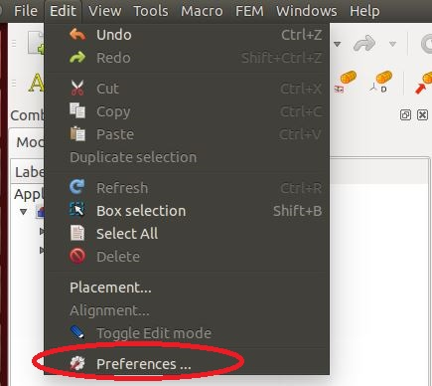
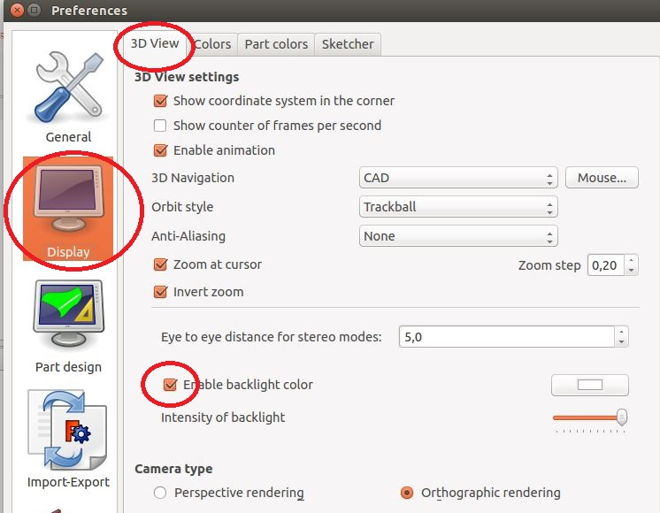
Static FEM model – Post-processing
Modifying the display:
In order to make viewing of the results with the pipeline more visible, the display needs to be changed to suit the viewing needs.
The user can change certain display parameters by going to the “Edit” tab and then “Preferences” as indicated.
A preferences task dialogue will appear, select “Display” and under the “3D view” tab check the “Enable backlight” checkbox.

Slide 20
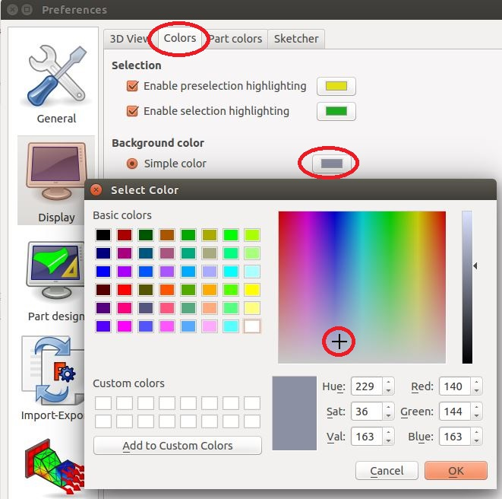
Static FEM model – Post-processing
Modifying the display:
The user can also modify the background color of the document window to suit the viewing requirements.
Go to the “Colors” tab, under the “Background color” click on the box next to the “Simple color” radio button. Choose the grey color so that there is better visualization.

Slide 21
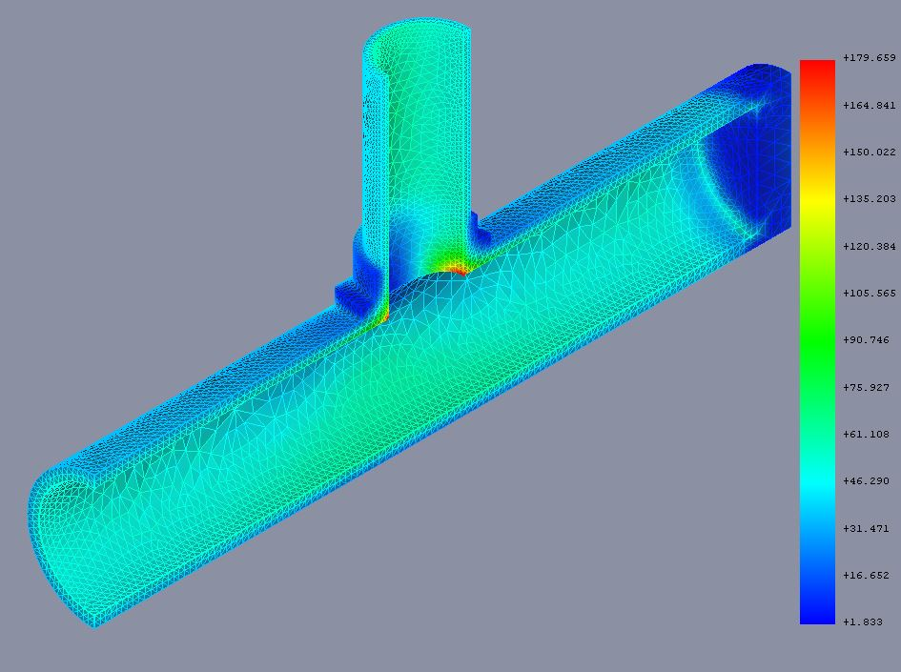
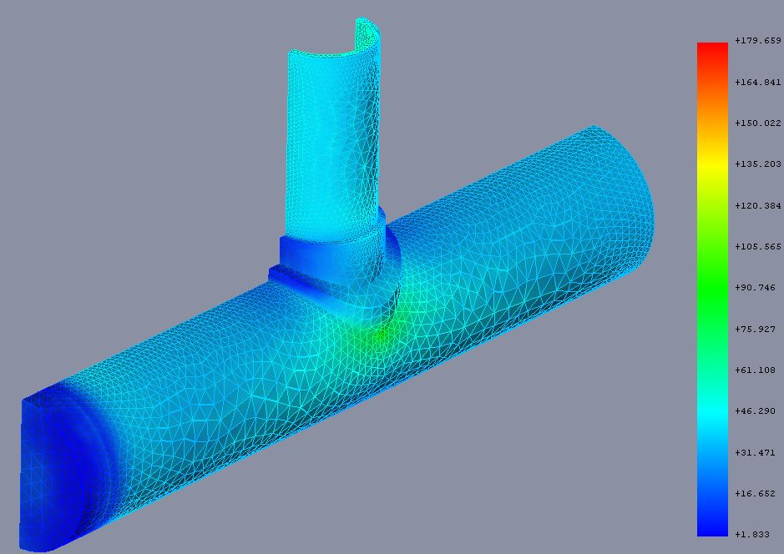
Static FEM model – Post-processing
Result pipeline:
The display should be similar to that indicated in the pictures. A results bar is now displayed alongside the geometry.
The colors in the results bar represent a certain stress range mapped on to the geometry.
The same results bar also appears for the other result sets (i.e. temperature or displacement)
When creating a new pipeline task change the transparency of the main pipeline or hide the pipeline object

Slide 22
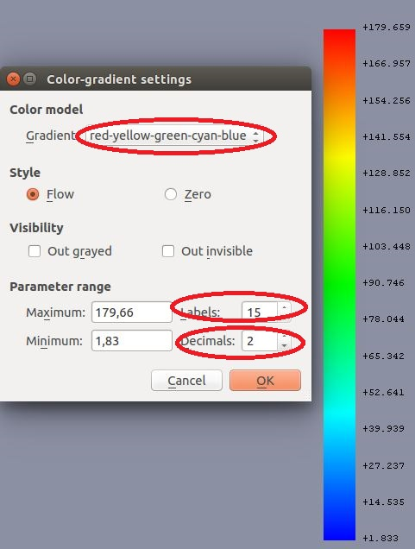
Static FEM model – Post-processing
Pipeline results bar:
To configure the results bar, double click on it. A task dialogue appears.
The user can then change the color scheme used for the results bar with “Gradient”.
The user can also change the number of labels used as well as the number of decimals

Slide 23

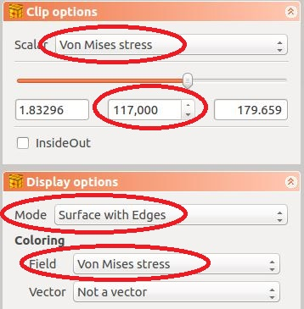
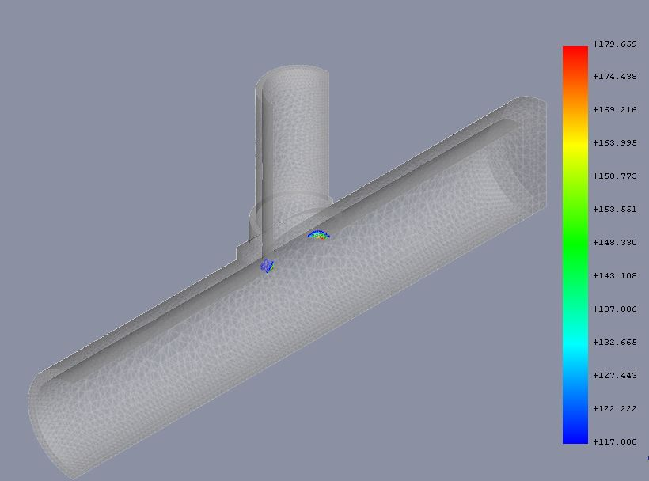
Static FEM model – Post-processing
Scalar Clip:
The user can choose to display the areas in the geometry that experience stresses (as well as displacements or temperatures) above/below a certain value using the “InsideOut” checkbox.
Click on <Define/create a clip filter that clips a field with a scalar value>. Under “scalar” select “Von Mises stress” and in the spin edit box enter a value of 117. This is the design stress for the pipe For “mode” choose “Surface with edges” and the “field” should be “Von Mises stress”. To map these regions onto the original geometry, change the transparency of the main pipeline accordingly and change the pipeline “ field” to “none”.

Slide 24
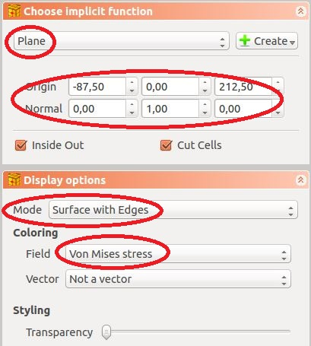
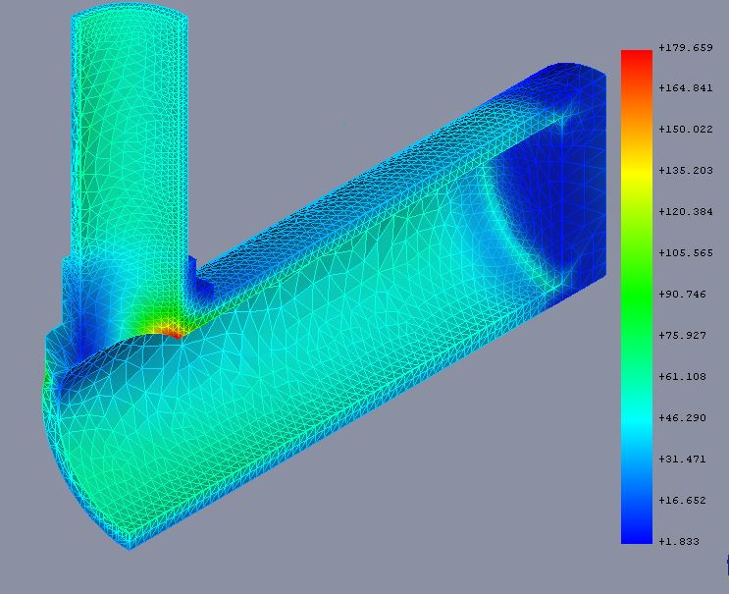
Static FEM model – Post-processing
Clipping plane/sphere:
The user can choose to display the stresses within or outside a sphere/plane.
Click on <Define/create a clip filter which uses functions to define clipped region> and create a plane which has a normal direction in the Y direction and cuts the T-pipe half way through as indicated.
Display mode should be set to “Surfaces with edges” and the field should be Von Mises stress.
There are other advanced post processing capabilities available to the user which are not demonstrated, but is recommended that the user work through them.

Slide 25
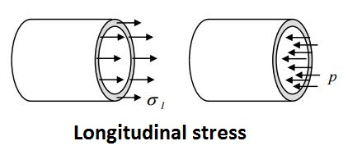
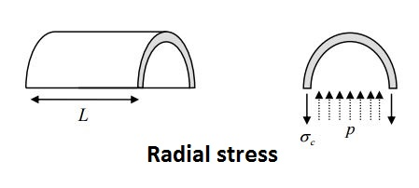
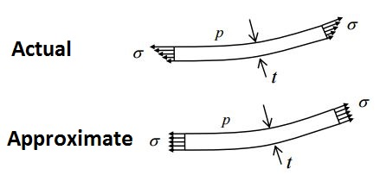
Static FEM model – Post-processing
Verification:
Verification should be performed on all results produced by all FEM models as a spot check to ensure that the FEM solver has done its calculations correctly. The radial and longitudinal stresses on the branch and the shell of the FEM model are to be verified.
1. Thin walled cylinder theory is to be used for verification.
2. The stresses obtained using the thin walled cylinder theory are to be compared to stresses obtained in the FEM model.
3. Radial stress varies along the thickness from a stress equal to the applied pressure to zero on the surface experiencing no pressure.

Slide 26
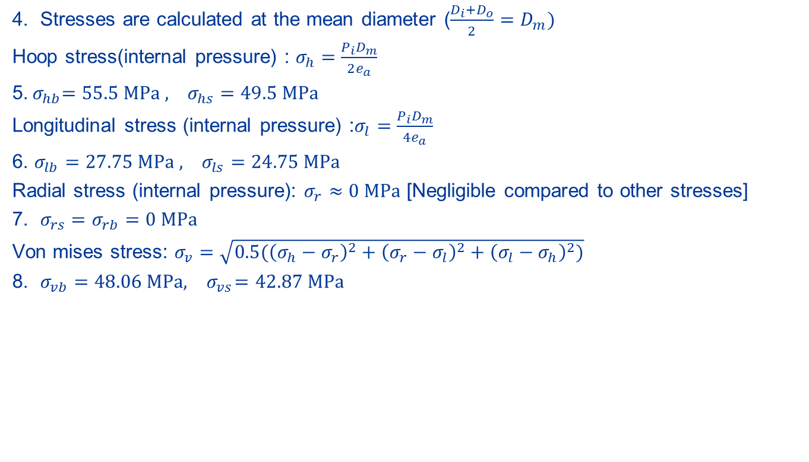
Static FEM model – Post-processing
Verification:
4. Stresses are calculated at the mean diameter ($\frac{D_{i}+D_{o}}{2}=D_{m})$
Hoop stress(internal pressure) : $σ_{h}=\frac{P_{i}D_{m}}{2e_{a}}$
5.${ σ}_{hb}=55.5 MPa , σ_{hs}=49.5 MPa$
Longitudinal stress (internal pressure) :$σ_{l}=\frac{P_{i}D_{m}}{4e_{a}}$
6. $σ_{lb}=27.75 MPa , σ_{ls}=24.75 MPa$
Radial stress (internal pressure): $σ_{r}≈0 MPa$ [Negligible compared to other stresses]
7. $σ_{rs}=σ_{rb}=0 MPa$
Von mises stress: $σ_{v}=\sqrt{0.5({\left(σ_{h}−σ_{r}\right)}^{2}+{\left(σ_{r}−σ_{l}\right)}^{2}+{\left(σ_{l}−σ_{h}\right)}^{2})}$
8. $σ_{vb}=48.06 MPa, { σ}_{vs}=42.87 MPa$

Slide 27
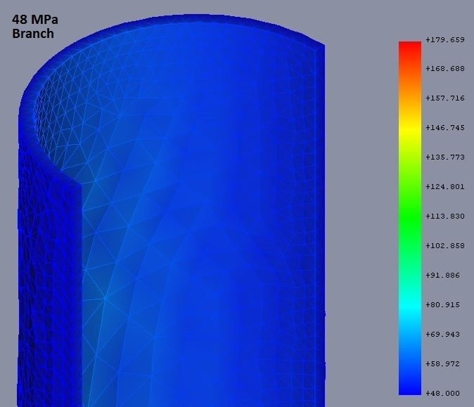
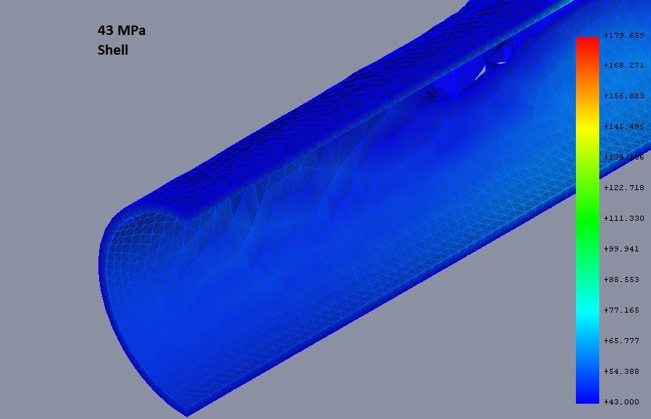
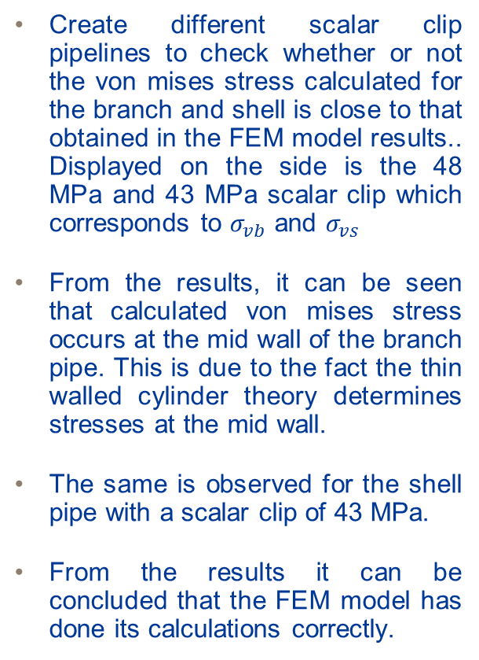
Static FEM model – Post-processing
Verification:
Create different scalar clip pipelines to check whether or not the von mises stress calculated for the branch and shell is close to that obtained in the FEM model results.. Displayed on the side is the 48 MPa and 43 MPa scalar clip which corresponds to $σ_{vb}$ and $σ_{vs}$
From the results, it can be seen that calculated von mises stress occurs at the mid wall of the branch pipe. This is due to the fact the thin walled cylinder theory determines stresses at the mid wall.
The same is observed for the shell pipe with a scalar clip of 43 MPa.
From the results it can be concluded that the FEM model has done its calculations correctly.

Slide 28
Static FEM model – Post-processing
Validation:
The process of validation has to be performed in order to ensure that the FEM model represents the correct problem, that is, have the correct boundary conditions been applied and has the right analysis been run in the FEM model?
Validation can be done through testing and obtaining experimental results. For this particular case, strain on a real T-pipe could be measured and used to calculate stress using hookes law. This stress would then be compared to that obtained in the model. If the stress and stress distribution is the same, then it means that the FEM model represents the problem correctly.

Slide 29
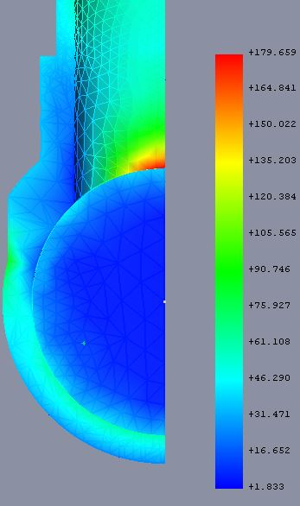
Static FEM model – Post-processing
Analyzing the results:
Now that it has been verified that the calculations are right and validated that we have indeed solved the correct problem, analysis of the results can be done and meaningful conclusions can be made.
The area with the highest stress, is the branch and shell pipe junction of their internal surfaces. This is due to the change in geometry (a stress raiser).
It can also be observed that the reinforcement experiences stresses lower than that of the shell (and branch) due to the fact that it is thicker.

Slide 30
Static FEM model – Post-processing
Analyzing the results:
The average stress across the thickness of the reinforcement is below the design. The design is therefore sufficient.
It is important to note that Von Mises stress is not the only the result set that produces meaningful information, in this particular case it was very important in determining whether or not the design of the reinforcement was sufficient.
The peak stresses at the junction are above the design stress and slightly above the proof stress, localized yielding may occur but the overall failure of the t-pipe will not occur.

Slide 31


Static FEM model – Post-processing
Saving the FreeCAD project:
To save the project under a different name, go to File and then click on <Save As>.
A task dialogue appears, choose the file directory, enter the file name and click <Save>.
It is important to save the project under a different file name because the file “T-pipe CAD” is going to be used in other FEM models.

Slide 32

END

